Slide 1

Photonics and quantum science in Latvia – smart specialization...
scenarios for long term growth
Presentation 19-12-2013
Saeima - Innovation and research subcommittee
Economic, agricultural, environmental and regional policy committee

Slide 2
TOPICS
Context
Smart specialization
European Commission strategies
  Key Enabling Technologies
  Stairways to Excellence
Photonics markets
Latvian photonics R&D capabilities
Opportunity created by FOTONIKA-LV project
Three scenarios for Latvia
  Business as usual
  NAP2020 plan is achieved
  Photonics a national development priority
Recommendations

Slide 3
Context
Present status
  exports are primarily low value-added commodities
  Latvia is last in EU in innovation, investment in RDI
  Low use of R&D by business
Latvia’s future depends on developing a knowledge based economy producing high-value added products and services
  Central theme of NAP2020
Foundation for the future is scientific and innovation capacity
  Education
  Strategically directed R&D capabilities
  Financing and policy that supports innovation and commercialization

Slide 4
Smart specialization (ris3)
Regional focus on fields that promise sustainable, high returns.
  Links R&D, education, production, marketing and sales, other capabilities
Deciding factor in structural funds and cohesion funds.
  Projects not in smart specialization will not be funded through these funds.
EC strategies for R&D funding
  Key enabling technologies
  Innovation Divide and Stairways to Excellence
Structural funds can leverage Horizon 2020 projects – if in smart specialization

Slide 5
Photonics technologies and markets
Photonics – control of photons (light) to achieve human objectives
  Fiberoptics – faster internet, telecommunications
  Biophotonics – safer, cheaper medical diagnostics and treatments
  Laser technologies – measurement, manufacturing, communications
  Lighting systems – key to quality of life
  Entertainment systems – image information recording
  Optics, astronomy, quantum technologies

Slide 6
Photonics, Quantum sciences and technologies is an appropriate smart specialization domain
In this domain world wide competitive industry in photonics meet world wide recognized scientific research in quantum sciences and laser applications
Out of 8000 publications 2000 highly cited publications are in this domain in Latvia
Therefore this smart specialization domain in Latvia has strong background in competitive industry and stairways to excellence via world class research capacity

Slide 7
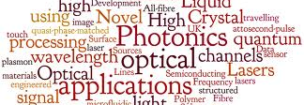
Photonics – horizontal technology across multiple markets and sectors
Thousands of market applications with high margin opportunities!

Slide 8

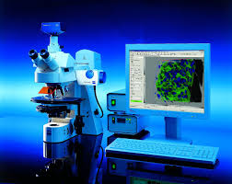
photonics technologies for the very small to very large

Slide 9
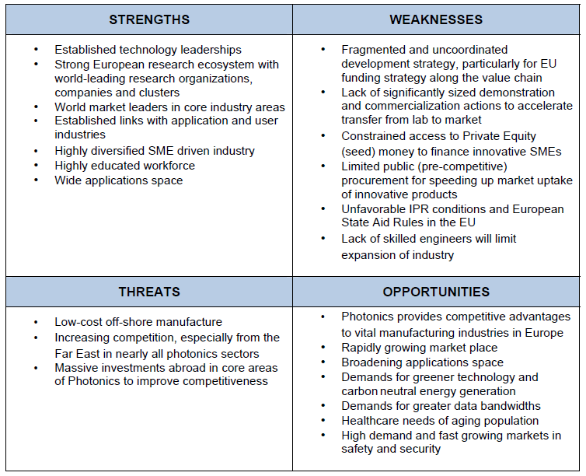
SWOT Photonics in Europe

Slide 10
Photonics - a key enabling technology
European Commission (EC) defined photonics as key to the long term competitiveness of the EU
2014-2020 EC funding priorities intended to accelerate development of photonics technologies
Photonics involved in 10% of jobs in EU
Global photonics market
  2012 exceed 300 billion €
  forecast to grow to 480 billion € by 2015
  Implicit growth rate - 18% per annum overall. Specific technologies much higher growth.

Slide 11
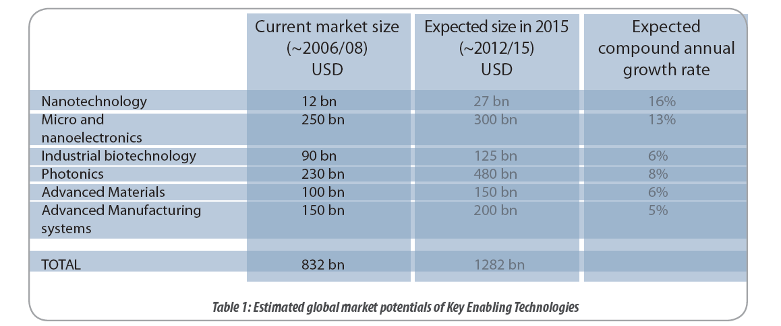
Key-enabling technologies

Slide 13
EC agreement with EIB
KETS should be a priority investment area in Europe!
The European Investment Bank will offer improved access to financing for KETS
The importance of KETs in delivering sustainable growth, creating high-value jobs and solving societal challenges has also been underlined in the reinforced industrial policy Communication of October 2012.
  COM(2012) 341, A European Strategy for Key Enabling Technologies – A bridge to growth and jobs.
  COM(2012) 582, A Stronger European Industry for Growth and Economic Recovery.

Slide 14
KETS logic
Three years of study, nearly 2,000 pages of supporting documentation, buy-in from industry, unions, leading researchers
KETS can lead to market disruption and continued competitive advantage to EU manufacturers
Alternative – lose manufacturing and basis for wealth
Strategy worked for Sweden and Germany faced with low cost competition from Asia
KETS priorities attempt to apply a similar strategy to the entire EU
30% H2020 linked to KETS. Favorable financing to get to production fast.
Notes:
Price competition, race to bottom
Slide- away from comodities. Special products copete on special prodcts

Slide 15
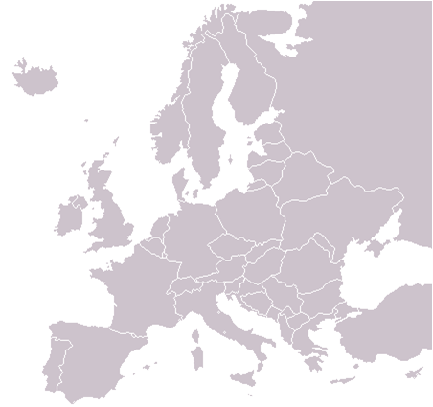
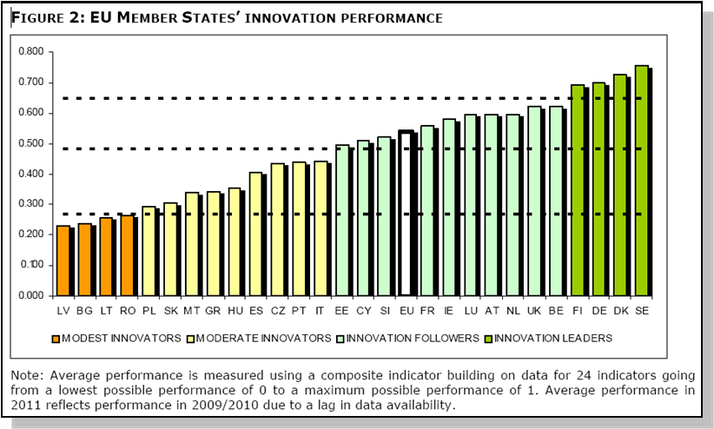
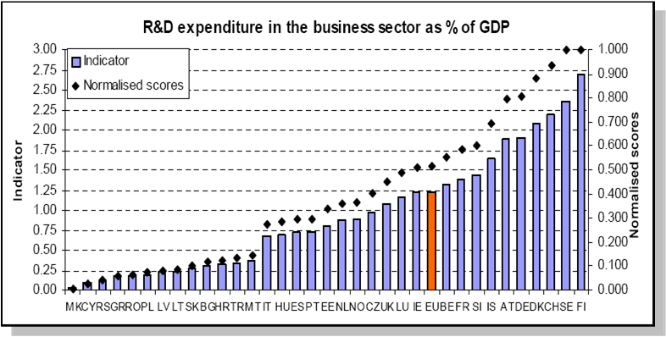
Innovation performance
R&D
Investment

Slide 16
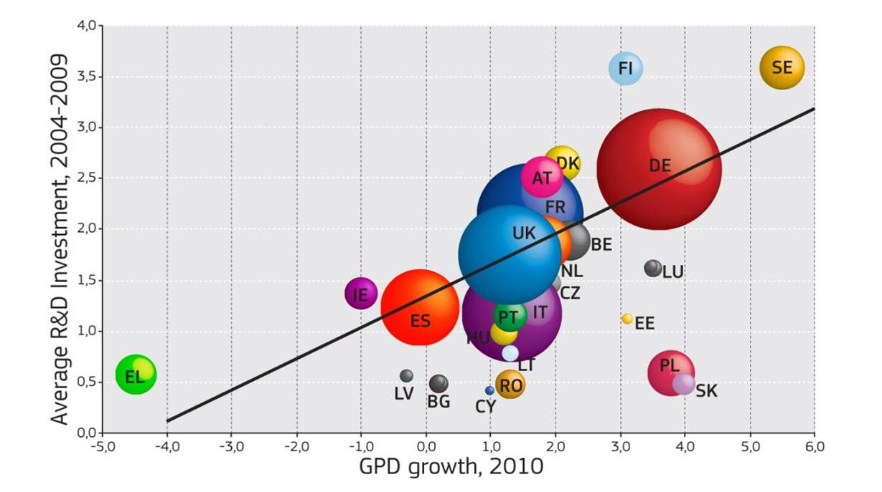
R&D investment fuels growth

Slide 17
the innovation divide is a danger to latvia
The brain drain from Latvia can be expected to intensify
  The EU needs one million more scientists by 2020 to meet development goals
Latvia must fully use Stairway to Excellence programs to retain top scientists and to recruit and repatriate new scientists
Exploit synergies between Horizon 2020 and Cohesion Fund
  Can combine structure funds and H2020 in the same project
Focus on priority areas where excellence can be achieved

Slide 18
Latvian photonics R&D capabilities
1990 Latvia had world class capabilities in lasers, astronomy, geodetics, optoelectronics and other technologies.
  Some equipment and manpower from that period is still available, but is aging and underutilized.
  Collaboration with key international R&D institutes built, and continues
Structural fund investments period 2005-2012 in modern photonics R&D equipment
  Capacity increased but underutilized due to underinvestment in personnel to use R&D equipment in projects
Potentially competitive in specific fields with world’s best

Slide 19
Photonics R&D in Latvia
Latvian institutes
Capabilities
University of Latvia – multiple institutes
  Atomic Physics and Spectroscopy
  Astronomy
  Geodynamics and Ģeoinformatics
  Solid State Physics Institute / 40% photonics
    Crystal and Optoelectronic Materials
    Photonic Material Physics
  Quantum computing
  Quantum technology
1/5 of Latvian R&D personnel involved in photonics and quantum technology - over 700 scientists.
Photonics and quantum science and quantum technology is a field where Latvia has achieved excellence

Slide 20
Identifying excellence in R&D

Slide 21
Identifying excellence
European Research Council grants
  Andris Ambainis
Coordination of European level projects
  Andris Ambainis – quantum computing
  FOTONIKA-LV
  Organic Synthesis Institute
  Photonics and quantum science and technology have won about 18 million Euro in EU program funding – ERC, Framework, others.
  Photonics have also received awards from ESA and EURATOM
  Viatcheslavs Kashchayevs, was recognized at Davos as one of top 25 researchers for work on quantum technology.

Slide 22
Latvian photonics industry
Total sales – about 43 million €, mostly export
Active firms
Z-Light, LTD; Baltic Scientific Instruments, LTD; ISP Optics, LTD; Sidrabe, LTD; GroGlass, LTD; Optilas, LTD; Optron, LTD Biolitec,LTD | Spatial Initiatives Eventech, LTD BurgerMetrics, LTD HEE Photonic Labs, LTD EuroLCDs LTD Fush, LTD Difraks Sol, LTD

Slide 23
Baltic Photonics Cluster
Formed in 2011 with 26 member firms and institutes from Estonia, Latvia and Lithuania
Annual revenue of firms in 2012 - €120 M
Dr. Jānis Spīgulis of the Atomic Physics & Spectroscopy Institute is the current president
Latvia has the greatest concentration of R&D capabilities in BPC
Latvian leadership can stimulate greater success of cluster

Slide 24
Many emerging products
Skin sensor – Dr. Spigulis
3D scanning sensor
Archival astronomical database
Femtosecond laser comb for ultraprecise determination of movement
Green lighting systems
Flexible X-ray detector

Slide 25
Photonics is key to space science
Latvia is strongly represented in space related initiatives:
  Astronomy Institute one of largest Schmidt telescopes in Europe
  Geodynamics observatory in Riga first to find Sputnik in 1957. Track record of subsequent achievement.
Very important that Latvia be on track to join the European Space Agency

Slide 26
Do Latvia’s R&D priorities differ from EU?
Energy & environment
Pharmacy and biomedicine
Information and communications
Lettonica
Agriculture and food processing
Forest products and water resources
Nanotechnology and functional materials
Public health and clinical medicine
Political economy and public administration
Nanotechnology
Micro & nanoelectronics
Industrial biotechnology
Photonics
Advanced materials
Advanced manufacturing systems
Nationaly significant R&D
EU key-enabling technologies
Notes:
Enerģijas un vides resursu ieguves un ilgtspējīgas izmantošanas tehnoloģiju Valsts nozīmes pētniecības centrs, ietverot arī Transporta un mašīnbūves centra attīstību;
Farmācijas un biomedicīnas Valsts nozīmes pētniecības centrs, ietverot farmaceitisko tehnoloģiju studiju un pētījuma centra un biofarmācijas centra izveidi;
Informācijas, komunikāciju un signālapstrādes tehnoloģiju Valsts nozīmes pētniecības centrs, ietverot Kosmisko datu apstrādes centra izveidi;
Latviešu valodas, kultūrvēsturiskā mantojuma un radošo tehnoloģiju Valsts nozīmes pētniecības centrs;
Lauksaimniecības resursu izmantošanas un pārtikas Valsts nozīmes pētniecības centrs;
Meža un ūdens resursu Valsts nozīmes pētniecības centrs;
Nanostrukturēto un daudzfunkcionālo materiālu, konstrukciju un tehnoloģiju Valsts nozīmes pētniecības centrs;
Sabiedrības veselības un klīniskās medicīnas Valsts nozīmes pētniecības centrs;
Valsts nozīmes pētniecības centrs sociālekonomikā un sabiedrības vadībā.

Slide 27
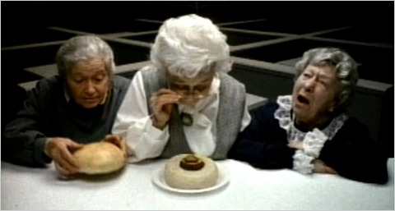
National RD&I Strategy
Where’s the beef KETS?
Where’s the photonics?

Slide 28
Smart specialization
Power of a laser vs ordinary light
Strategy will have greatest chance of significant success where EU KETS is coherent with regional smart specialization.
All structure fund and cohesion funding dependent on smart specialization
Notes:
Modernization of critical R&D equipment required to seize new market opportunities in
3D imaging,
laser-ranging,
biophotonics, medicine
mining (including asteroid),
geoinformatics
spectroscopy
Quantum computing
Spinoff of new businesses
X-ray imaging with flexible, ultra-lightweight detectors
Crystal growth
Astronomical information for asteroid mining
3-D imaging
Solar powered water purification
Quantum computing

Slide 29
FOTONIKA-LV – a model for transforming R&D strategy
FOTONIKA-LV directly addresses the photonics KETS for Latvia
Capacity building through repatriation and recruitment of top specialists
Strengthen international R&D collaboration
Modernize critical R&D equipment
Spinoff new businesses
Public outreach, education
Need to involve “Stairways to Excellence” to build R&D capabilities than can compete with best in EU.

Slide 30
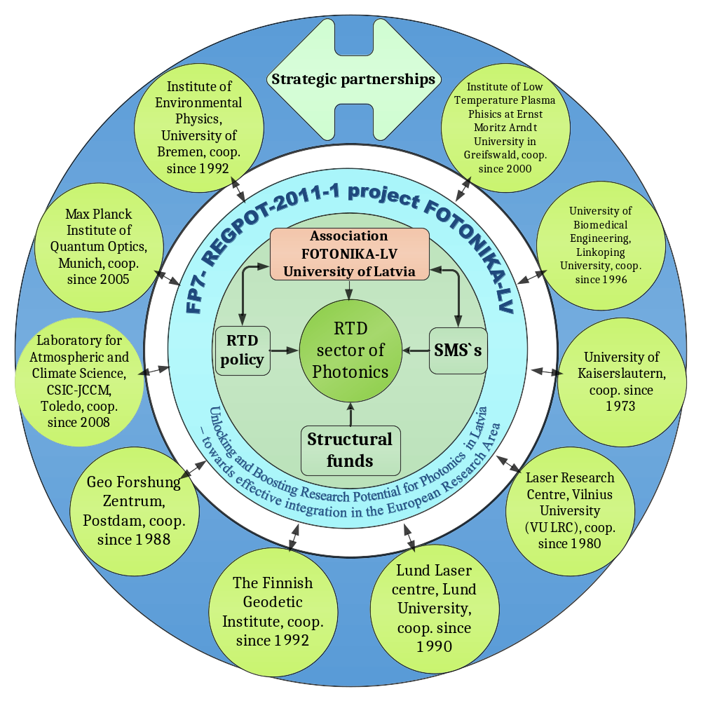

Slide 31

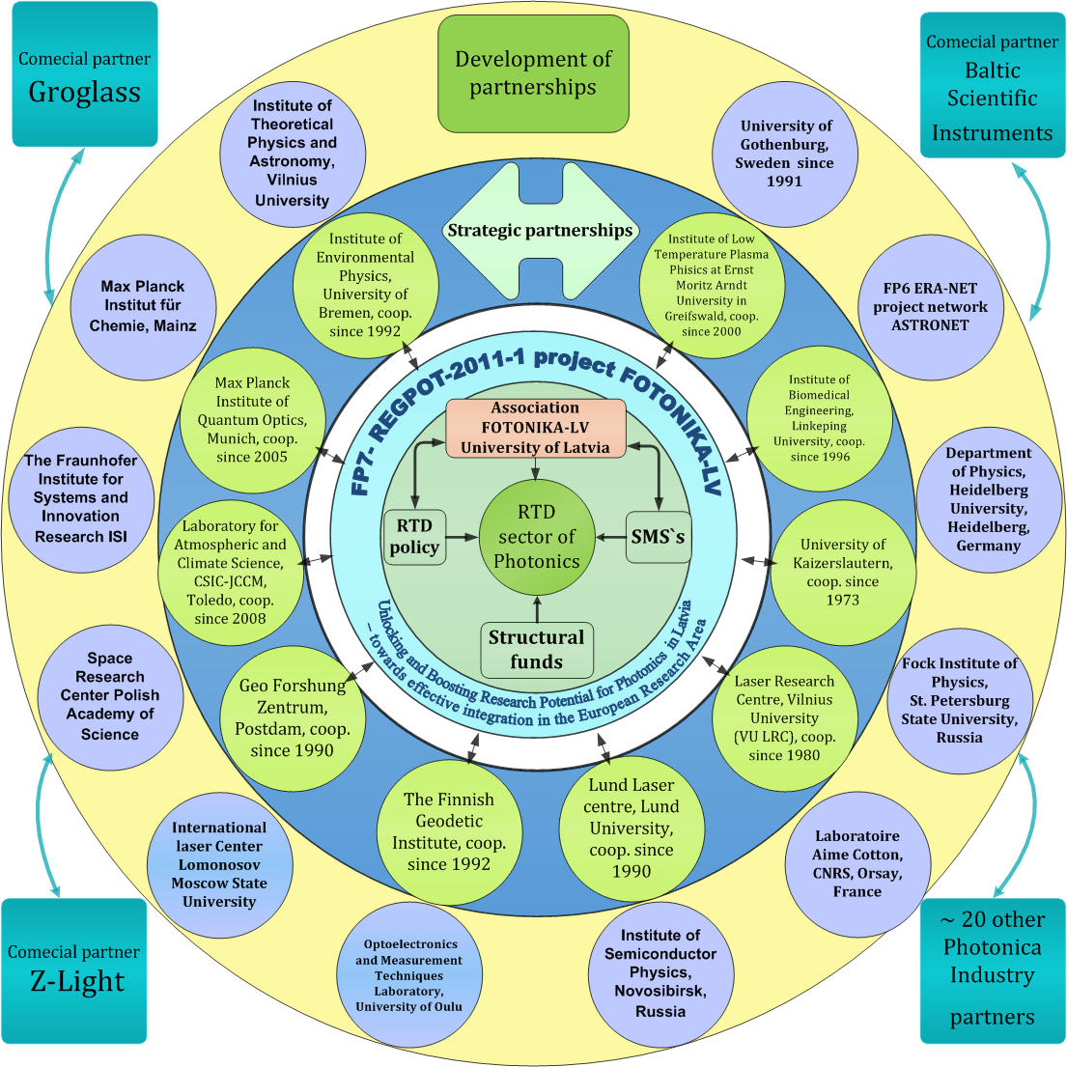
Ubelis, FOTONIKA-LV/285912, SSC 27/08/2012
Notes:
31

Slide 32
Scenarios
Business as usual
National development plans succeed
Photonics a national priority

Slide 33
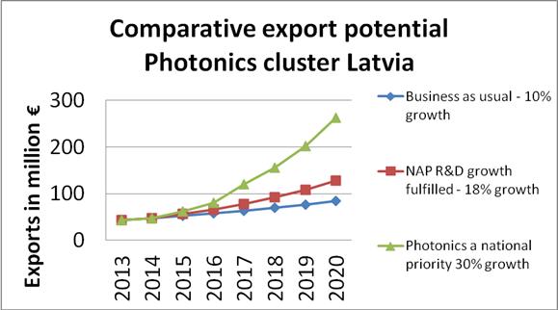

Slide 34
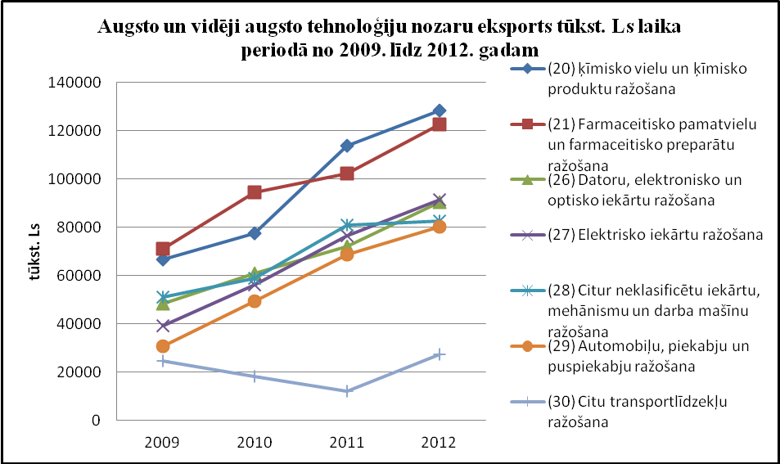

Slide 35
Business as usual
Investment in R&D remains at recent levels and the NAP goal of 1.5% of GDP is not fulfilled.
Capabilities built by FOTONIKA-LV are not further strengthened
Repatriated personnel return to host countries
Photonics spinoffs are not encouraged
Photonics association does not continue and capabilities revert to less productive state within the LU structure
Emerging photonics industry in Latvia loses its single point of contact for R&D support relating to photonics
Rate of new venture formation in photonics returns to historical rate of 2-3 per decade.
New specialist training lags behind industry needs and photonics businesses in Latvia face increasing shortages

Slide 36
NAP R&D investment goal achieved
Combined public – private investment in R&D reaches 1.5% of GDP by 2020
Base funding for research institutes increased such that all working researchers can receive at least the national average income as base pay
Structure fund rules 2014-2020 favor increased public R&D investment leading to doubling of R&D staff by 2020
Increased staffing leads to greater utilization of R&D equipment which increases R&D services, increases rate of winning Framework grants and increases new venture formation.
Increased funding for venture development increases rate of new venture formation in all technologies.
Photonics growth in Latvia exceeds EU growth rates at 18% per annum.

Slide 37
Photonics needs to be a priority for Latvia
Photonics businesses in Latvia are high tech leaders – Sidrabe, GroGlas, Baltic Scientific Instruments, Z-Light, Bio-Light Tech,
  Other photonics SMEs --Difraks-SOL, HEE Photonics Lab, Euro-LCDs, Holographics, Hologramma, Spatial Initiatives, Fush, Optron, Eventech, Optilas, BurgerTech, Dardedze Holografia
High potential for new venture formation in high margin niche markets
  Very large market with multiple segments where
  latest technology has advantage
  EU funding and programs available
High potential for Stairways to Excellence funding due to demonstrated excellence

Slide 38
Photonics needs to be a priority for Latvia
Space is increasing seen as high potential for private business
  At least two companies have been formed to do asteroid mining,
  Several private companies are in the launch business
  Several Moon mining, moon transportation, lunar fuel depot and others have been formed.
Photonics is the primary way that Latvia participates in space through ESA and NASA projects
  Astronomy, geodetics, geo-informatics, laser ranging, sensors

Slide 39
Photonics needs to be a priority for Latvia
Photonics is a field where Latvia has established excellence recognized at the EU level.
  FOTONIKA-LV is the first major Framework project to be coordinated by Latvia
  The 3.9 million € FOTONIKA –LV project won in a field of hundreds of competing proposals with only 7% success rate
  Institutes that comprise the FOTONIKA-LV participate in a consortium that includes 12 leading European institutes. See chart.

Slide 40
Photonics: technology to achieve economic breakthrough
Photonics is recognized by the European Commission as a key-enabling technology
  Information and Communication
  Industrial Production, Manufacturing and Quality
  Life Sciences and Health
  Emerging Lighting, Electronics and Displays
  Security, Metrology and Sensors
  Design and Manufacturing of Components and Systems
Huge global market potential - annual growth 18%
  2012 / $300 billion
  2015 / $480 billion forecast
  EU 20% global market share
  Many market niches with high margin potential
EU photonics employs 290,000, subcontractors many more

Slide 41
Make photonics a national R&D priority
Increased potential for successful, even blockbuster products from Latvia
Fully utilize Stairways to Excellence
  reverse brain drain
Attract world class photonics R&D to Latvia
  Nobel level researchers
  Photonics companies to conduct R&D in Latvia
Increase the number of PhD, MS and BS level students in photonics disciplines
  Double the number of photonics researchers active in Latvia to 1400+ by 2020

Slide 42
Economic development priorities
Recruit internationally recognized photonics specialists for high profile projects
Strengthen related specialties – medical research, space technologies
Promote photonics companies to invest in Latvia
  Medical
  Space
  Telecommunications
  Computing
  Manufacturing

Slide 43
Recommendations R&D POLICY
Recognize photonics as a priority in R&D planning and economic development to fully take advantage of EC tools and resources aimed at KETS and Stairways to Excellence and specifically photonics.
Establish the Photonics Center as a legal entity that can host Institute of Atomic Physics and Spectroscopy, Institute of Astronomy, Institute of Geodesy and Geoinformatics and other photonics related R&D in Latvia
  Directly receive funding from the Ministry of Education and Science
  Independently of LU apply for grants and contract R&D services with industry and international organizations
  Accept MS and PhD students as well as postdocs doing funded research

Slide 44
Recommendations contd.
Develop photonics and quantum science and quantum technologies as a smart specialization for the Baltic States
Work to make the Baltic Photonics Cluster a dynamic force in all three Baltic States.

Slide 45


Riga Photonics Center
Šķūņu iela 4
Rīga, LV-1050
Latvia
Vidvuds Beldavs Vid.beldavs-@-fotonika-lv.eu +371-2786201

